Slide 1



Department of Computer Science and Engineering
Cybercrime blockchain-enabled security framework to detect and defend ransomware attacks
Team Members Name / Register Number
NALLAPANENI PENCHALA BALA TEJA- 211420104174
PARSAM CHAITANYA - 211420104189
N.BHARATH - 211420104036
S.SOPHANA JENNIFER
ASSISTANT PROFESSOR
Dr N PUGHAZENDI
PROFESSOR

Slide 2
Introduction
A Cybercrime blockchain-enabled security framework to detect and defend ransomware attacks to ensure high protection and prevention. Most of the organizations, such as financial institutes and healthcare sectors are targeted by ransomware attacks. Ransomware assaults are among the most frightening types of cyber- attacks, and they are not confined to a specific sector or the countries. Blockchain is a tamper- proof technology, which is more secure, robust and decentralized in nature. Features of blockchain can add more security for detection and mitigation of ransomware more effectively. The application of machine learning algorithms and techniques is to identify and recognize patterns, anomalies, or specific objects within data.

Slide 3
Objective of the Project
Develop a framework that leverages blockchain technology to enhance security measures, ensuring data integrity, confidentiality, and availability.
Create a robust system that can withstand cyber threats such as ransomware attacks, data breaches, and other malicious activities through decentralized consensus mechanisms and cryptographic protocols.

Slide 4
LITERATURE SURVEY
S.NO | TITLE | CONTENT | AUTHOR | YEAR
1 | Ransomware: A Survey and Trends | Ransomware are a recent scareware, a threat that is increasing gradually for last couple of years. Usually it encrypts users’s files or steal/delete important information and holds the decryption key until a ransom is paid by the victim, which is mostly in bitcoins due to their untraceable properties. In this work, we have conducted a survey to comprehend more than 40papers that consists of Windows based ransomware families from last 4 years by creating a benchmark for evaluating ransomware attacking methodologies, payment methods. Thus, providing a way of instigating for other researchers to come out with some new solutions to control their growth and to avoid their attacks. This work would be the ultimate opportunity to expand and organize research efforts in future work by applying some early preventions and strategies to defeat the semalicious software’s. | Sana Aurangzeb, Muhammad Aleem, Muhammad Azhar Iqbal and Muhammad Arshad Islam | 2021

Slide 5
LITERATURE SURVEY
S.NO | TITLE | CONTENT | AUTHOR | YEAR
2 | Blockchain as privacy and securitysolution for smart environments: ASurvey | Blockchain was always associated with Bitcoin, cryptocurrencies, and digital asset trading. However, the benefits of Blockchain are far beyond that. It has been recently used to support and augmentmany other technologies, including the Internet-of-Things (IoT). IoT, with the help of Blockchain, pavesthe way for futuristic smart environments, like smart homes, smart transportation, smart energy trading,smart industries, smart supply chains, and more. To enable these smart environments, IoT devices,machines, appliances, and vehicles, will need to intercommunicate without the need for a centralized trusted party. Blockchain can replace third trusted parties by providing secure means of decentralizationin such trustless environments. | MAAD EBRAHIM, ABDELHAKIM HAFID, and ETIENNE ELIE | 2022
5

Slide 6
Problem Statement
The digital landscape is increasingly prone to cybercrime, with file hacking posing a significant threat to individuals and organizations alike.
Hackers employ various techniques like malware, social engineering, and exploiting vulnerabilities to gain unauthorized access to, modify, or steal sensitive files.

Slide 7
Proposed System
In the proposed system, we focused on antecedence of ransomware attack as well as aftermath. We also provided a demo attack of Locker Ransomware and Crypto Ransomware to get real-time experience and to aware of it. We will also continuously monitor the system, if any suspicious files is detected it will be removed automatically. We will take backup of the user data to recover it later, in case of ransomware attack so that we don’t need to pay ransom to the attacker. In detection on ransomware we will mainly focuses on the portable executable files which plays a major role in gaining access of the system. We will do the detection of ransomware in Portable Executable files using Honeypot dataset and then the features/signatures are extracted followed by Feature Selection, Correlation and Classification using Machine Learning to detect that the executable file is Legitimate or Infected.

Slide 8
Advantage
The continuous monitoring of the system and automatic removal of files, in the event of suspicious activity followed by detection of ransomware and recovery of data make this proposal to stand out than the others.

Slide 9
Existing System
In the Existing System, they mainly focused only on the aftermath of ransomware attack by detection of ransomware and recovery of data. They didn’t proposed how to prevent the system from the ransomware attack.

Slide 10
Disadvantage
The proposed system didn’t focused on the antecedence of ransomware attack will continue to be a significant drawback.

Slide 11
Modules
User
Attacker
Detection of Ransomware Using Machine Learning

Slide 12
User
User will login to their account to take back-up of their resources in blockchain, In order to retrieve their data in case of ransomware attack. User can scan their files to know that the files are infected or not. At the worst case, if are’nt no chances to recover their data after the attack they can pay the ransom securely through blockchain to the attacker.

Slide 13
Attacker
Attacker show the demo of Locker Ransomware and Crypto Ransomware from their Login. Attacker also receives ransom after ransomware attack from the victim in exchange for restoring access to their data.

Slide 14
Detection of Ransomware using Machine Learning:
In our proposed system, Machine Learning will play a vital role in the detection of malware portable executable files. The user will scan the executable files using react user interface and then features from the files are extracted followed by Feature Selection, Correlation and Classification using Machine Learning to detect that the executable file is Legitimate or Infected. To achieve this, the suitable dataset will be downloaded and data pre-processing will be done to remove outliers and to check if there are any null values. After data pre-processing, feature selection will be done using variance threshold to select the most important features followed by correlation to remove the highly correlated features. We will use the Lazy classifier algorithm to determine which algorithm gives better accuracy. Based on the result we will use the highly accurate classifier to detect the portable executable file is malware or legitimate.

Slide 15
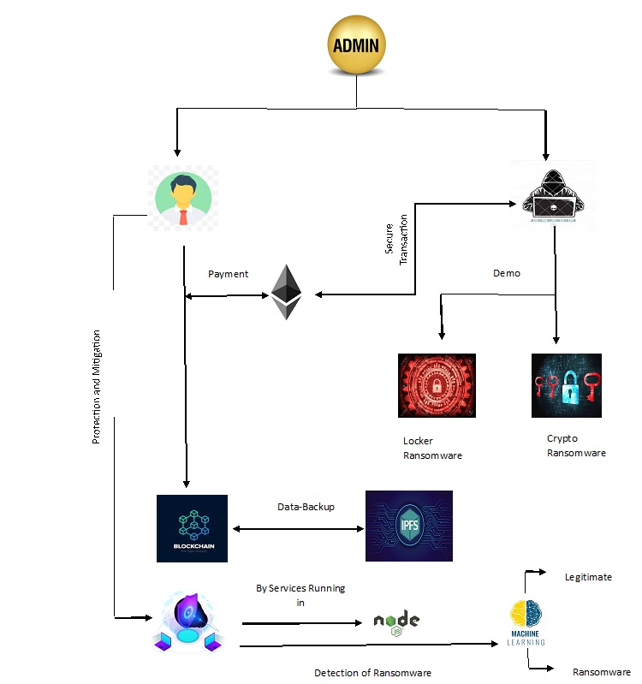
System Architecture

Slide 16
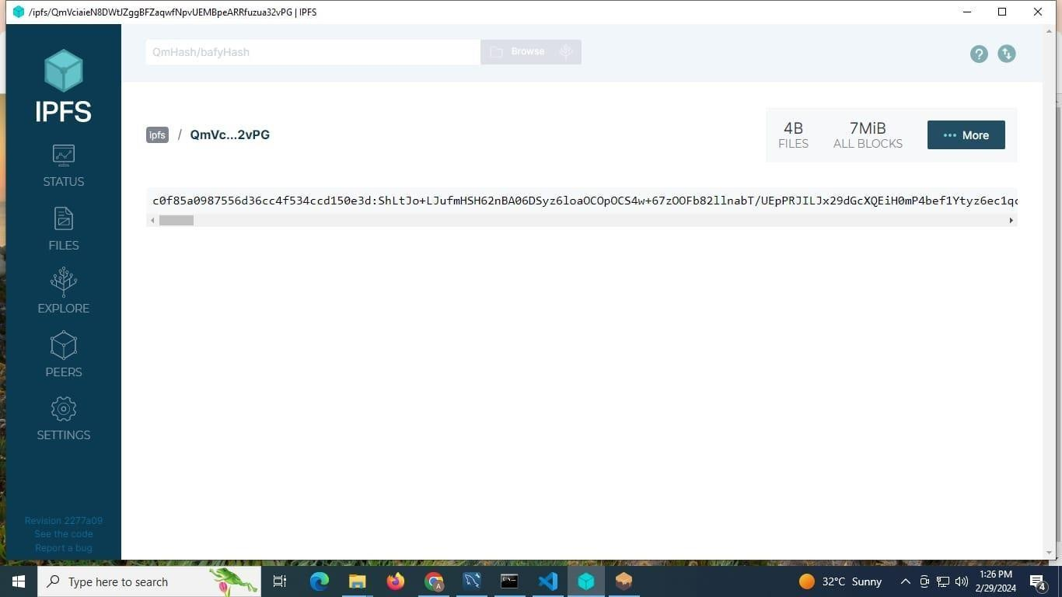
Testing /Performance Evaluation / Results

Slide 17
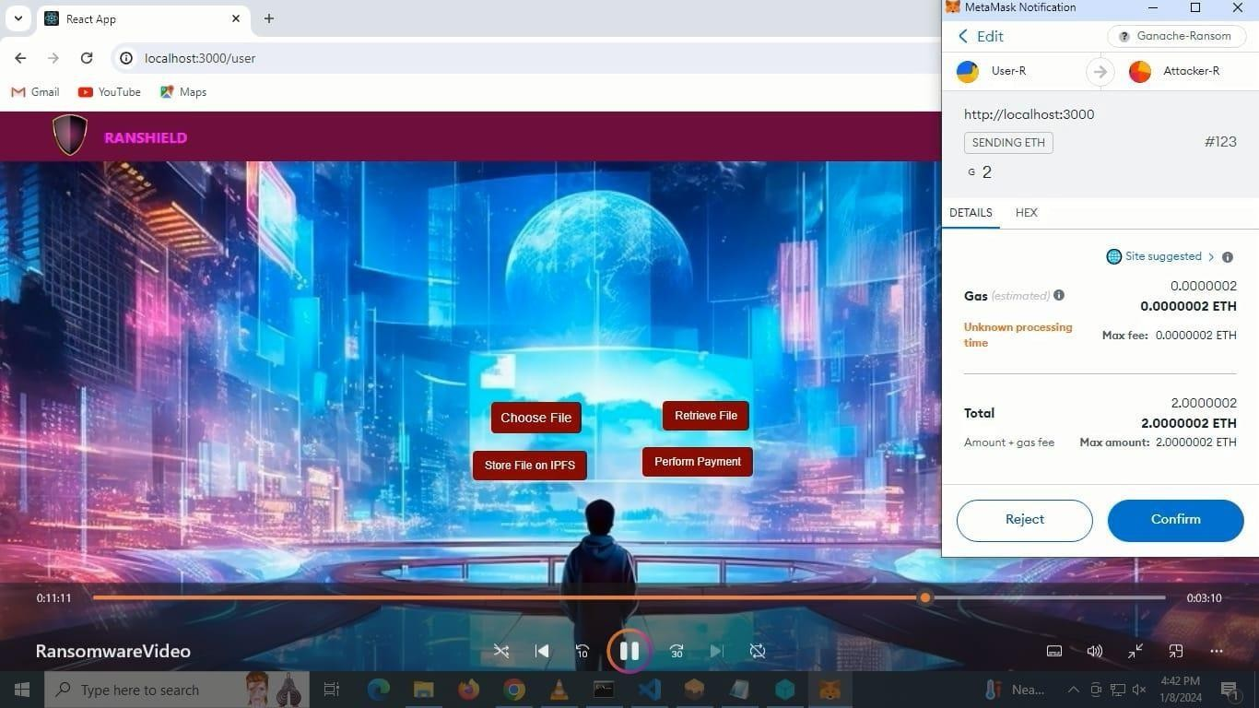
Screen Shots

Slide 18
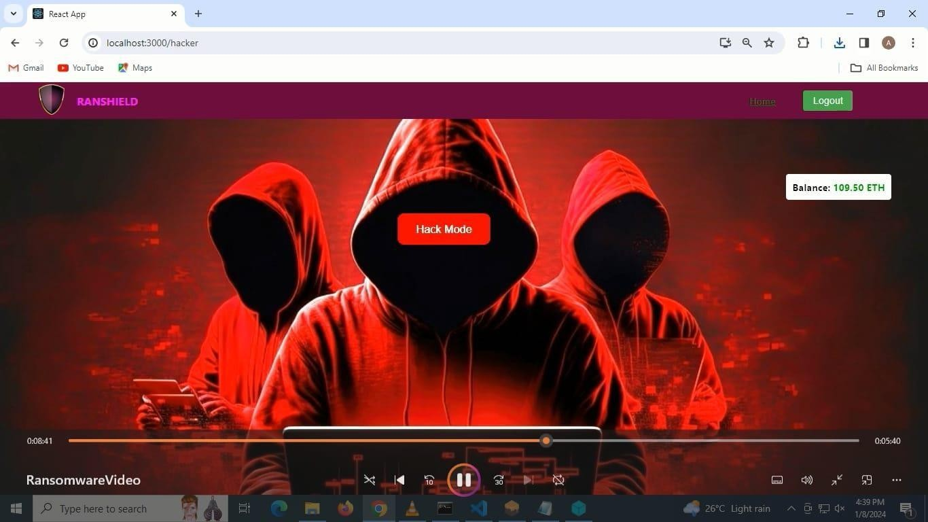
Screen Shots

Slide 19
Future Enhancement
We can further improve the recovery of data after the ransomware attack by decrypting the encrypted data in case of Crypto Ransomware. Most of the Ransomware attacks encrypts the data to demand the ransom. So, future enhancements focuses on decrypting the encrypted data to break the backbone on Attacker idealogy.

Slide 20
REFERENCES
[1]B. Watkins. “The Impact of Cyber Attacks on the Private Sector”.Briefing Paper, Association for International Affair, pp.12, 2014
[2] N. Andronio.-“Heldroid: Fast and Efficient Linguistic-Based Ransomware Detection”, 2015
[3] M. Barbulescu, A. Stratulat, V. T. Popescu, E. Simion.“RSA Weak Public Keys available on the Internet”. In International Conference for Information Technology and Communications. Springer International Publishing, pp. 92-102, 2016
[4] O’Brien. “Dridex: Tidal waves of spam pushing dangerous financial Trojan”, Symantec White paper, 2016

